Slide 1
Basic Statistics Normal Distribution

Slide 2
Normal Distributions
A random variable X with mean μ and standard deviation σ is normally distributed if its probability density function is given by

Slide 3



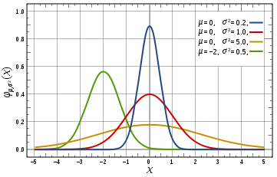
Normal Distribution
Pdf
Mean μ
Median μ
Mode μ
Cdf
Variance σ²
Moment Generating function
Changing the mean varies the peak position on the x axis
Decreasing the variance moves the peak up and narrows down the shape
Characteristics:
Symmetric about the mean μ
If X₁ (μ₁, σ₁)and X₂ (μ₂, σ₂)are two independent Normal Random Variables then
Standardization of curve implies N(0,1) is done by substituting Z=(X -μ)/σ
About 68% values are within one Std Dev, 95% within two and 99.7% within 3

Slide 4
The Shape of Normal Distributions
90
μ
110
Why symmetrical? Let μ = 100. Suppose x = 110.
Now suppose x = 90

Slide 5
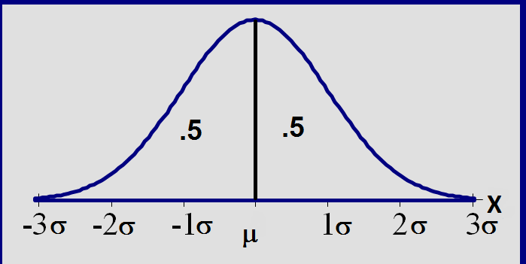
Total area =1; symmetric around µ

Slide 6
The effects of μ and σ
How does the standard deviation affect the shape of f(x)?
σ= 2
σ =3
σ =4
How does the expected value affect the location of f(x)?
μ = 10
μ = 11
μ = 12

Slide 7
µ = 3 and σ = 1
μ
X
0
3
6
9
12
8
A family of bell-shaped curves that differ only in their means and standard deviations.
µ = the mean of the distribution
σ = the standard deviation

Slide 8
µ = 3 and σ = 1
μ
X
0
3
6
9
12
µ = 6 and σ = 1
μ
X
0
3
6
9
12

Slide 9
μ
µ = 6 and σ = 2
X
0
3
6
9
12
8
µ = 6 and σ = 1
μ
X
0
3
6
9
12
8

Slide 10
P(6 < X < 8)
µ = 6 and σ = 2
X
0
3
6
9
12
Probability = area under the density curve
P(6 < X < 8) = area under the density curve between 6 and 8.
a
b
a
b
X

Slide 11
P(6 < X < 8)
µ = 6 and σ = 2
X
0
3
6
9
12
8
Probability = area under the density curve
P(6 < X < 8) = area under the density curve between 6 and 8.
6
8
a
b
a
b
6
8
X

Slide 12
Probability = area under the density curve
P(6 < X < 8) = area under the density curve between 6 and 8.
6
8
a
b
a
b
6
8
X

Slide 13
f(x)
P(a < X < b)
Probabilities:
area under
graph of f(x)
X
a
b
P(a < X < b) = area under the density curve between a and b.
P(X=a) = 0
P(a < x < b) = P(a < x < b)

Slide 14
Standardizing
Suppose X~N(μ, σ)
Form a new random variable by subtracting the mean μ from X and dividing by the standard deviation σ:
(X−μ)/ σ
This process is called standardizing the random variable X.

Slide 15
Standardizing (cont.)
(X−μ)/ σ is also a normal random variable; we will denote it by Z:
Z = (X−μ)/ σ
Ζ has mean 0 and standard deviation 1: E(Z) = μ = 0; SD(Z) = σ = 1.
Ζ ∼ Ν(0, 1)
The probability distribution of Z is called the standard normal distribution.

Slide 16
Standardizing (cont.)
If X has mean μ and stand. dev. σ, standardizing a particular value of x tells how many standard deviations x is above or below the mean μ.
Exam 1: μ=80, σ=10; exam 1 score: 92
Exam 2: μ=80, σ=8; exam 2 score: 90
Which score is better?

Slide 17
µ = 6 and σ = 2
X
0
3
6
9
12
8
(X-6)/2
µ = 0 and σ = 1
.5
.5
Z
-3
-2
-1
0
1
2
3

Slide 18
Pdf of a standard normal rv
A normal random variable x has the following pdf:

Slide 19
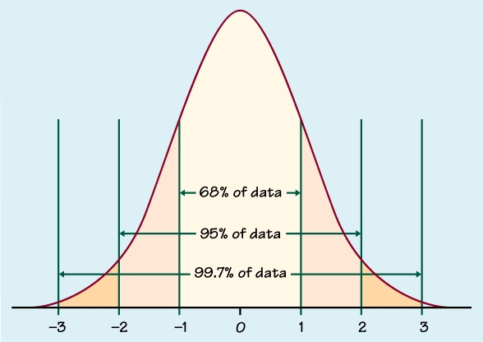
Standard Normal Distribution

Slide 20
Standard Normal Distribution
.5
.5
.5
.5
Z
-3
-2
-1
0
1
2
3
Z = standard normal random variable
μ = 0 and σ = 1

Slide 21
Important Properties of Z
#1. The standard normal curve is symmetric around the mean 0
#2. The total area under the curve is 1;
so (from #1) the area to the left of 0 is 1/2, and the area to the right of 0 is 1/2

Slide 22
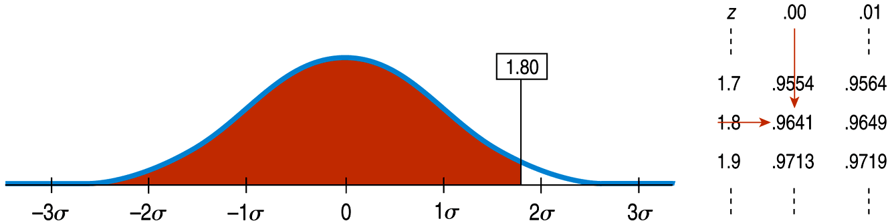
Finding Normal Percentiles by Hand (cont.)
Table Z is the standard Normal table. We have to convert our data to z-scores before using the table.
The figure shows us how to find the area to the left when we have a z-score of 1.80:

Slide 23
Areas Under the Z Curve: Using the Table
P(0 < Z < 1) = .8413 - .5 = .3413
.50
.3413
.1587
Z
0
1

Slide 24
Standard normal probabilities have been
calculated and are provided in table Z.
The tabulated probabilities correspond
to the area between Z= -∞ and some z₀
P(-∞ <Z<z₀)
Z = z₀
z | 0.00 | 0.01 | 0.02 | 0.03 | 0.04 | 0.05 | 0.06 | 0.07 | 0.08 | 0.09
0.0 | 0.5000 | 0.5040 | 0.5080 | 0.5120 | 0.5160 | 0.5199 | 0.5239 | 0.5279 | 0.5319 | 0.5359
0.1 | 0.5398 | 0.5438 | 0.5478 | 0.5517 | 0.5557 | 0.5596 | 0.5636 | 0.5675 | 0.5714 | 0.5753
0.2 | 0.5793 | 0.5832 | 0.5871 | 0.5910 | 0.5948 | 0.5987 | 0.6026 | 0.6064 | 0.6103 | 0.6141
… |  |  | … |  |  | … |  |  |  | …
1 | 0.8413 | 0.8438 | 0.8461 | 0.8485 | 0.8508 | 0.8531 | 0.8554 | 0.8577 | 0.8599 | 0.8621
… |  |  | … |  |  | … |  |  |  | …
1.2 | 0.8849 | 0.8869 | 0.8888 | 0.8907 | 0.8925 | 0.8944 | 0.8962 | 0.8980 | 0.8997 | 0.9015
… |  |  | … |  |  | … |  |  |  | …

Slide 25
Example – continued X~N(60, 8)
0.8944
0.8944
0.8944
P(z < 1.25)
= 0.8944
0.8944
0.8944
0.8944
In this example z₀ = 1.25
z | 0.00 | 0.01 | 0.02 | 0.03 | 0.04 | 0.05 | 0.06 | 0.07 | 0.08 | 0.09
0.0 | 0.5000 | 0.5040 | 0.5080 | 0.5120 | 0.5160 | 0.5199 | 0.5239 | 0.5279 | 0.5319 | 0.5359
0.1 | 0.5398 | 0.5438 | 0.5478 | 0.5517 | 0.5557 | 0.5596 | 0.5636 | 0.5675 | 0.5714 | 0.5753
0.2 | 0.5793 | 0.5832 | 0.5871 | 0.5910 | 0.5948 | 0.5987 | 0.6026 | 0.6064 | 0.6103 | 0.6141
… |  |  | … |  |  | … |  |  |  | …
1 | 0.8413 | 0.8438 | 0.8461 | 0.8485 | 0.8508 | 0.8531 | 0.8554 | 0.8577 | 0.8599 | 0.8621
… |  |  | … |  |  | … |  |  |  | …
1.2 | 0.8849 | 0.8869 | 0.8888 | 0.8907 | 0.8925 | 0.8944 | 0.8962 | 0.8980 | 0.8997 | 0.9015
… |  |  | … |  |  | … |  |  |  | …

Slide 26
Examples
Area=.3980
P(0 ≤ z ≤ 1.27) =
0
1.27
z
.8980-.5=.3980

Slide 27
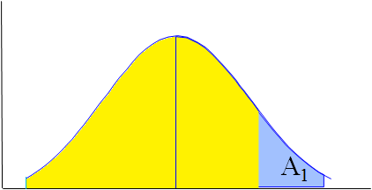
A₂
0
.55
P(Z ≥ .55) = A₁
= 1 - A₂
= 1 - .7088
= .2912

Slide 28
Examples
Area=.4875
P(-2.24 ≤ z ≤ 0) =
Area=.0125
0
z
-2.24
.5 - .0125 = .4875

Slide 29
P(z ≤ -1.85) = .0322

Slide 30
Examples (cont.)
.9968
A₁
A₂
A
A₁
z
-1.18
0
2.73
.1190
P(-1.18≤ z≤ 2.73) = A - A₁
= .9968 - .1190
= .8778

Slide 31
P(-1 ≤ Z ≤ 1) = .8413 - .1587 =.6826
vi) P(-1≤ Z ≤ 1)
.6826
.1587
.8413

Slide 32
6. P(z < k) = .2514
6. P(z < k) = .2514
.2514
.5
.5
-.67
Is k positive or negative?
Direction of inequality; magnitude of probability
Look up .2514 in body of table; corresponding entry is -.67

Slide 33
Examples (cont.) viii)
.7190
.2810

Slide 34
Examples (cont.) ix)
.8671
.1230
.9901

Slide 35
X~N(275, 43) find k so that P(x<k)=.9846

Slide 36
P( Z < 2.16) = .9846
.9846
Area=.5
.4846
.1587
0
2.16
Z

Slide 37
Example
Regulate blue dye for mixing paint; machine can be set to discharge an average of μ ml./can of paint.
Amount discharged: N(μ, .4 ml). If more than 6 ml. discharged into paint can, shade of blue is unacceptable.
Determine the setting μ so that only 1% of the cans of paint will be unacceptable

Slide 38
Solution

Slide 39
Assignments
1. Molly earned a score of 940 on a national achievement test. The mean test score was 850 with a standard deviation of 100. What proportion of students had a higher score than Molly? (Assume that test scores are normally distributed.)
2. An average light bulb manufactured by the Acme Corporation lasts 300 days with a standard deviation of 50 days. Assuming that bulb life is normally distributed, what is the probability that an Acme light bulb will last at most 365 days?
3. Acme Corporation manufactures light bulbs. The CEO claims that an average Acme light bulb lasts 300 days. A researcher randomly selects 15 bulbs for testing. The sampled bulbs last an average of 290 days, with a standard deviation of 50 days. If the CEO's claim were true, what is the probability that 15 randomly selected bulbs would have an average life of no more than 290 days?

Slide 40
Assignments
4. Suppose scores on an IQ test are normally distributed, with a mean of 100. Suppose 20 people are randomly selected and tested. The standard deviation in the sample group is 15. What is the probability that the average test score in the sample group will be at most 110?
5. The Acme Battery Company has developed a new cell phone battery. On average, the battery lasts 60 minutes on a single charge. The standard deviation is 4 minutes.
6. Let's revisit the problem presented above. The manufacturing department ran a quality control test, using 7 randomly selected batteries. In their test, the standard deviation was 6 minutes, which equated to a chi-square statistic of 13.5.
7. Suppose you randomly select 7 women from a population of women, and 12 men from a population of men. The table below shows the standard deviation in each sample and in each population.

Slide 41
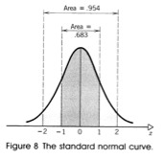
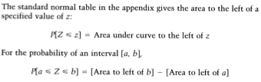
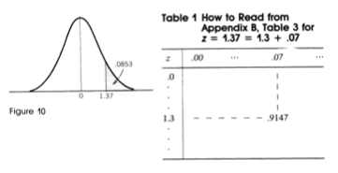
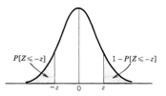

Slide 42
